Slide 1
Software Testing
Zeeshan Ali Rana

Slide 2
Software Faults and Failures Why Does Software Fail?
Fault (bug):
Programming or design error whereby the delivered system does not conform to specification (e.g., coding error, protocol error)
Failure:
Software does not deliver the service expected by the user (e.g., mistake in requirements, confusing user interface)

Slide 3
Software Faults and Failures Why Does Software Fail?
Wrong requirement: not what the customer wants
Missing requirement
Requirement impossible to implement
Faulty design
Faulty code
Improperly implemented design

Slide 4

Objective of Testing
Objective of testing: discover faults
A test is successful only when a fault is discovered
Fault identification is the process of determining what fault caused the failure
Fault correction is the process of making changes to the system so that the faults are removed

Slide 5
Elements of a Test Case
Purpose
Input
Expected Output
Actual Output
Sample Format:
Test Case ID | Purpose | Input Data | Expected Output | Actual Output | Result

Slide 6
Types of Faults
Algorithmic fault (logic)
Computation and precision fault
a formula’s implementation is wrong
Capacity or boundary faults
System’s performance not acceptable when certain limits are reached
Timing or coordination faults
Performance faults
System does not perform at the speed prescribed

Slide 7
Software Faults and Failures Typical Algorithmic Faults
An algorithmic fault occurs when a component’s algorithm or logic does not produce proper output
Branching too soon
Branching too late
Forgetting to initialize variable or set loop invariants
Comparing variables of inappropriate data types

Slide 8
Different Level of Failure Severity
Catastrophic: causes death or system loss
Critical: causes severe injury or major system damage
Marginal: causes minor injury or minor system damage
Minor: causes no injury or system damage

Slide 9
Testing Issues Who Performs the Test?
Independent test team
avoid conflict
personal responsibility vs need to discover faults
improve objectivity
allow testing and coding concurrently

Slide 10
Testing Issues Views of the Test Objects
Closed box or black box: functionality of the test objects
Equivalence Class, Boundary Value Analysis, Scenario-based, Decision Table based, State Machine based…
Clear box or white box: structure of the test objects
Control Flow
Basis Path, Branch, Statement, Decision…
Data Flow
Du Path, All-uses Path

Slide 11
Test Cases for Triangle Problem
Test cases based on input range
TC Id | What to test | A | B | C | EO
1 | EC1 of A | -10 | 15 | 15 | Value of A not in valid range
2 | EC1 of B | 15 | -10 | 15 | Value of B not in valid range
3 | EC1 of C | 15 | 15 | -10 | Value of C not in valid range
4 | EC3 of A | -205 | 15 | 15 | Value of A not in valid range
5 | EC3 of B | 15 | -205 | 15 | Value of B not in valid range
6 | EC3 of C | 15 | 15 | -205 | Value of C not in valid range
7 | EC2 of A, B, C | 15 | 15 | 15 | Equilateral
Note that we have made only one test case instead of three separate test cases to check ABC in valid range. This one test could be any test cases with any valid combination of A, B, C; for example see any of the valid range based test cases.
Test cases based on equivalence classes within valid range
TC Id | What to test | A | B | C | EO
1 | EC 1 | 15 | 15 | 15 | Equilateral
2 | EC 2 | 10 | 20 | 10 | Isosceles
3 | EC 3 | 5 | 6 | 7 | Scalene
4 | EC 4 | 1 | 2 | 10 | Not a triangle

Slide 12
Whitebox Testing Control Flow Graph
Cyclomatic Complexity = E – N + 2 = 9 – 9 + 2 = 2
Statement testing
Branch testing
Path testing
…

Slide 13
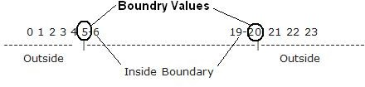
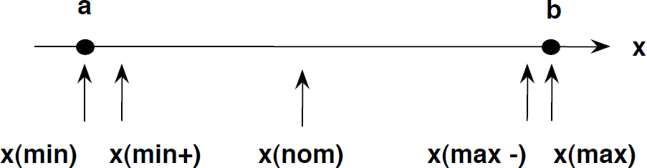
Boundary Value Analysis

Slide 14
Example
An Address text box which allows maximum 500 characters. So, writing test cases for each character once will be very difficult so that will choose boundary value analysis.

Slide 15
Example
An Address text box which allows maximum 500 characters. So, writing test cases for each character once will be very difficult so that will choose boundary value analysis.
No character
1 character
2 characters
499 characters
500 characters
501 characters

Slide 16
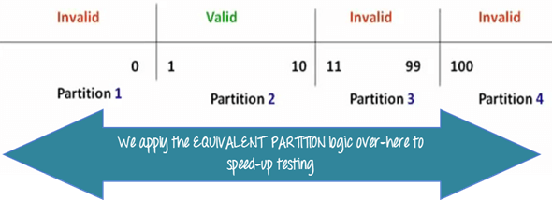
Equivalence and Boundary Value
Let's consider the behavior of Order Pizza Text Box Pizza values 1 to 10 is considered valid. A success message is shown.
Here is the test condition
Any Number greater than 10 entered in the Order Pizza field(let say 11) is considered invalid.
Any Number less than 1 that is 0 or below,
then it is considered invalid.
Numbers 1 to 10 are considered valid Any 3 Digit Number say -100 is invalid.

Slide 17
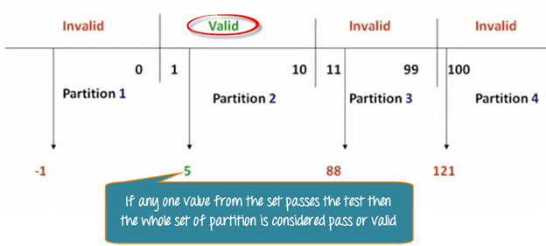
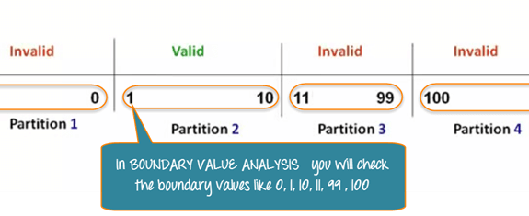
Equivalence and Boundary Value

Slide 18
Levels of Testing
Module testing, component testing, or unit testing
Integration testing
System Testing
Function testing
Performance testing
Acceptance testing
Installation testing

Slide 19
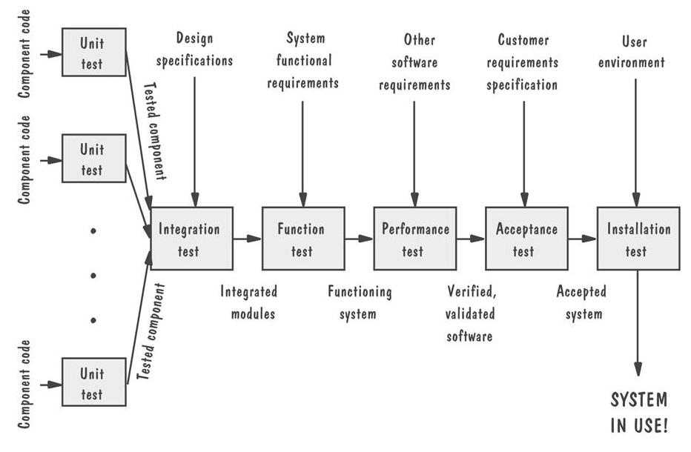
Levels of Testing Testing Organization Illustrated

Slide 20
Unit Testing Code Review
Code walkthrough
In a walkthrough, you present your code and accompanying documentation to the review team, and the team comments on their correctness.
Code inspection
In an inspection, the review team checks the code and documentation against a prepared list of concerns. It is more formal.

Slide 21
Unit Testing Steps in Testing
Determining test objectives
Selecting test cases
Executing test cases

Slide 22
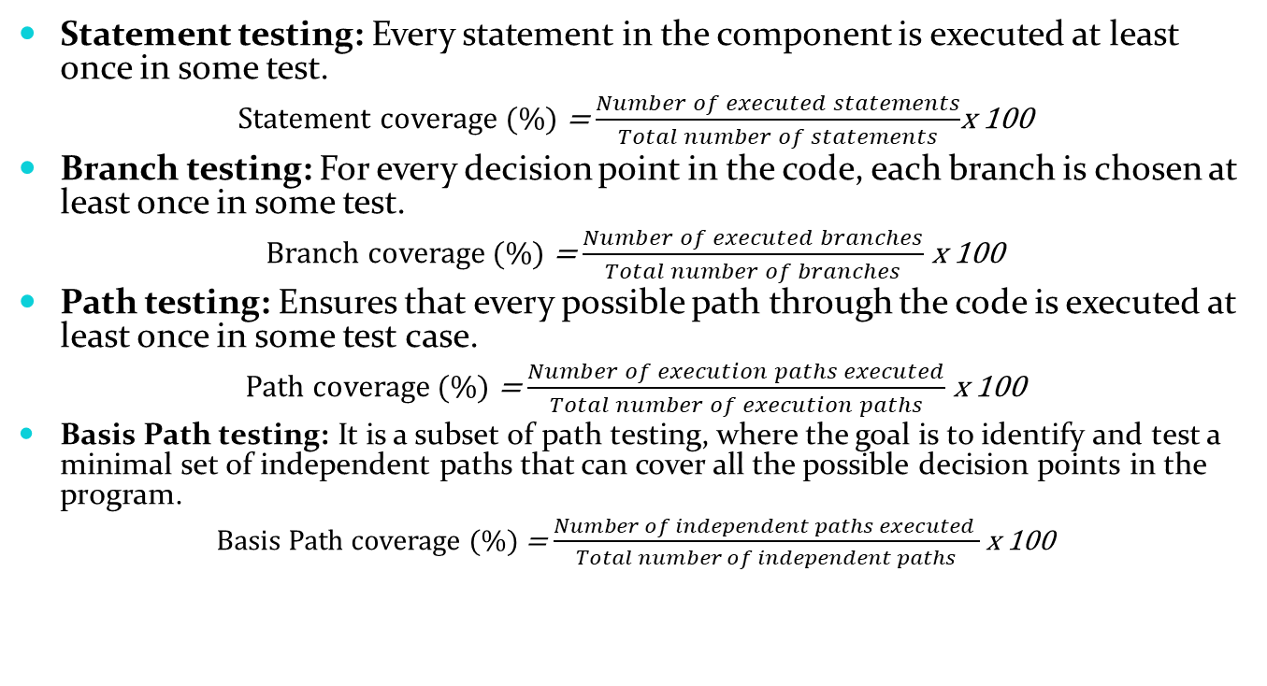
Unit Testing
Statement testing: Every statement in the component is executed at least once in some test.
Statement coverage (%) = $\frac{Number of executed statements}{Total number of statements}$x 100
Branch testing: For every decision point in the code, each branch is chosen at least once in some test.
Branch coverage (%) = $\frac{Number of executed branches}{Total number of branches}$ x 100
Path testing: Ensures that every possible path through the code is executed at least once in some test case.
Path coverage (%) = $\frac{Number of execution paths executed}{Total number of execution paths}$ x 100
Basis Path testing: It is a subset of path testing, where the goal is to identify and test a minimal set of independent paths that can cover all the possible decision points in the program.
Basis Path coverage (%) = $\frac{Number of independent paths executed }{Total number of independent paths}$ x 100
Notes:
Statement: Misses logic errors in conditional branches.
Branch: Doesn’t test all combinations of branches (e.g., nested conditions).
Path: Ensure all possible execution paths through the code are tested. For nested if and loops, it checks every possible way to reach the end. Number of paths can grow exponentially with loops, branches and nested conditions Basis Path: Ensures full branch and edge coverage. Uses cyclomatic complexity to determine number of independent paths. Avoids path explosion.

Slide 23
Integration Testing
Big-bang
Bottom-up
Top-down
Sandwich testing

Slide 24
Integration Testing Terminology
Component Driver: a routine that calls a particular component and passes a test case to it
Stub: a special-purpose program to simulate the activity of the missing component

Slide 25
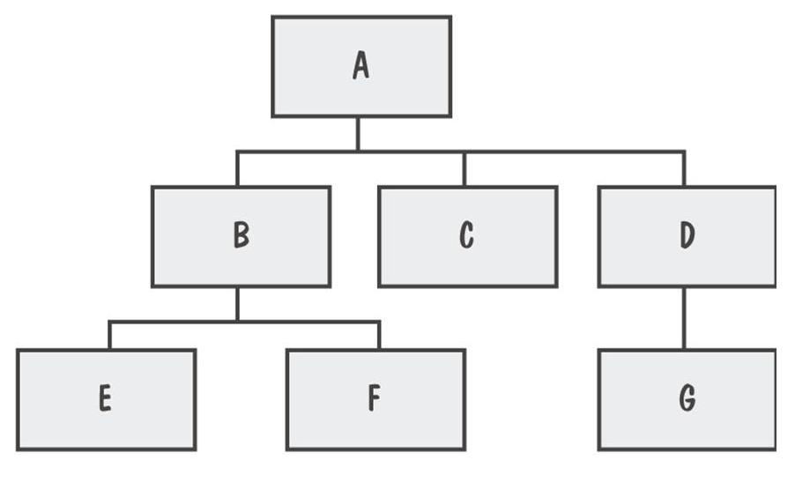
Integration Testing
System viewed as a hierarchy of components

Slide 26
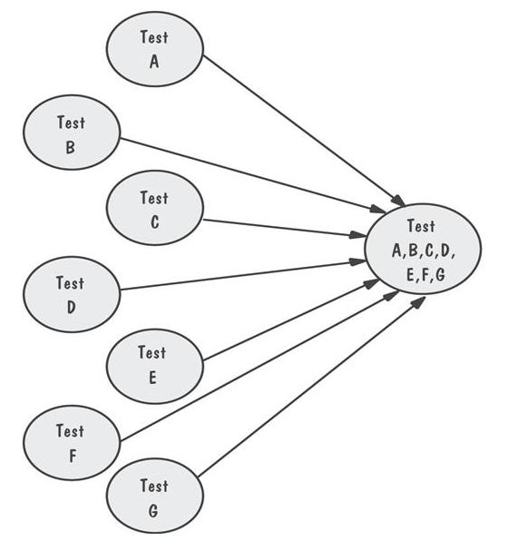
Integration Testing Bing-Bang Integration Example
All components integrated at once
Notes:
all or most of the modules or components of a software system are integrated simultaneously, and the system is tested as a whole

Slide 27
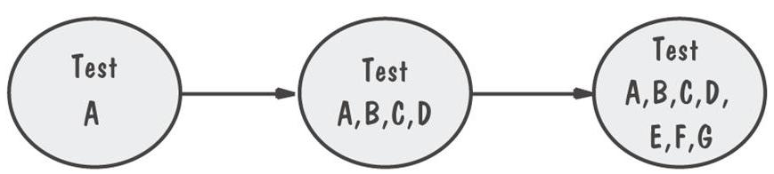
Integration Testing Top-Down Integration Example
Only A is tested by itself
Stubs of B, C and D are used at first level
N-1 stubs required (N=Number of nodes)
Locating faults?
Notes:
In integration testing, drivers and stubs are used to facilitate the testing of modules or components that depend on other modules/components which are not yet available or fully functional. They help simulate the behavior of these dependent modules/components, allowing testing to proceed smoothly.

Slide 28
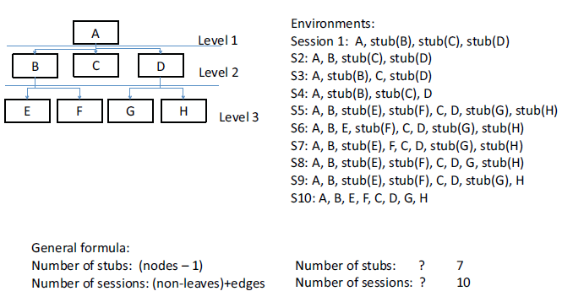
Integration Testing Top-Down Integration Example
Notes:
This helps in identifying and addressing major architectural issues early on.

Slide 29
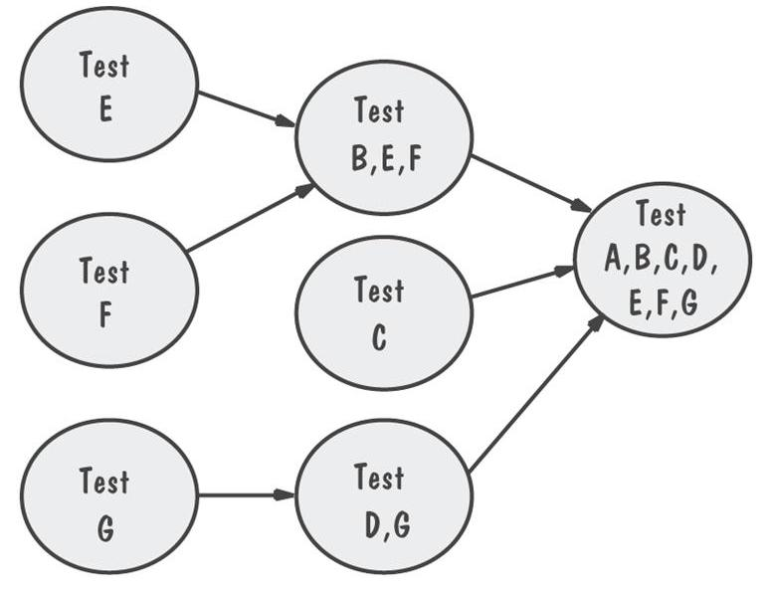
Integration Testing Bottom-Up Integration Example
Drivers are used to call the child functions
Drivers are relatively intelligent
N - leaves drivers
Locating faults?

Slide 30
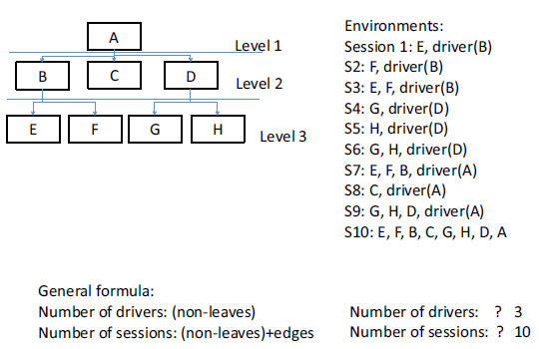
Integration Testing Bottom-Up Integration Example
Notes:
This approach helps in identifying and resolving issues related to individual components or modules.

Slide 31
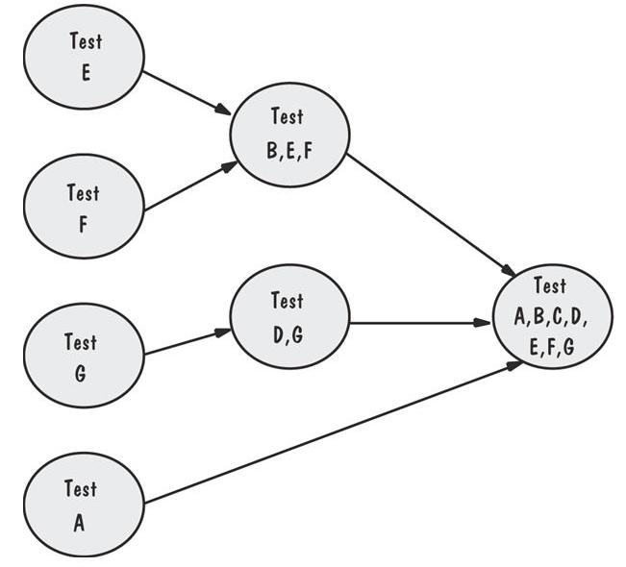
Integration Testing Sandwich Integration Example
Viewed system as three layers
Employ BU where
writing drivers is
not costly
Employ TD where
stubs are easier to
Write
Locating faults?
Notes:
Incremental integration: In sandwich integration testing, both top-down and bottom-up integration occur simultaneously, with integration proceeding incrementally from both ends towards the middle. This allows for a more balanced approach, leveraging the strengths of both top-down and bottom-up integration while mitigating their respective weaknesses.

Slide 32
System Testing
System is tested as a whole
Different types of testing considered during System Testing:
- Functional Testing (GUI) - Scalability
- Performance Testing - Sanity
- Usability - Smoke
- Load - Regression
- Volume - Compatibility
- Stress - Installation
- Security - Ad hoc

Slide 33
Steps to do System Testing
The following steps are important to perform System Testing:
Step 1: Create a System Test Plan
Step 2: Create Test Cases
Step 3: Carefully Build Data used as Input for System Testing
Step 3: If applicable create scripts to
- Build environment and
- to automate Execution of test cases
Step 4: Execute the test cases
Step 5: Fix the bugs if any and re test the code
Step 6: Repeat the test cycle as necessary

Slide 34
Principles of System Testing Regression Testing
Identifies new faults that may have been introduced as current one are being corrected
Verifies a new version or release still performs the same functions in the same manner as an older version or release

Slide 35
Principles of System Testing Regression Testing Steps
Inserting the new code
Testing functions known to be affected by the new code
Testing essential function of m to verify that they still work properly
Continuing function testing m + 1

Slide 36
Acceptance Tests Purpose and Roles
Enable the customers and users to determine if the built system meets their needs and expectations
Written, conducted and evaluated by the customers

Slide 37
Acceptance Tests Types of Acceptance Tests
Pilot test: install on experimental basis
Alpha test: in-house test
Beta test: customer pilot
Parallel testing: new system operates in parallel with old system
Notes:
Purpose: Beta testing occurs later in the development process, closer to the official release of the software.
Pilot testing is conducted earlier in the development process, typically after the completion of internal testing but before widespread deployment

Slide 38
Result of Acceptance Tests
List of requirements that
are not satisfied
must be deleted
must be revised
must be added

Slide 39
Installation Testing
Before the testing
Configure the system
Attach proper number and kind of devices
Establish communication with other system
The testing
to verify that the system has been installed properly and works

Slide 40
Software Testing Tools
Automated Testing Tools
Selenium, QTP, SilkTest, WinRunner, LoadRunner, Jmeter
Testing Management Tools
TestManager, TestDirector
Bug Tracking/Configuration Management Tools
Bugzilla, Jitterbug, SilkRadar

Slide 41
When to Stop Testing
No time left
No money left
Statistical Criteria
Number of defects found per week becomes lower than a set threshold

Slide 42
References
UCF Slides
Software Testing, A Craftsman’s Approach by Jorgensen

